Slide 1

Immersive Technology Development
Lesson 9:
Interactions in Virtual Reality
Elyas Chua-Aziz
cel9@np.edu.sg
Diploma in IM
October 2021

Slide 2
NOTES
3 Types of interactions:
Point and trigger (activate)
Something like secondary feature/function
Grab and trigger
Gun-like behaviour
If cannot solve the trigger issue, instead go into how to use the events
Select
Maybe do something simple like a light switch
Hover
Do highlighting with material, most basic
Grab and onCollision
Beat Saber-esque interaction
Key and lock behaviour?
Both need to be rigidbody only one can be kinematic
Alternatively one can be trigger
Go into how to implement teleport.
Detect joystick move, toggle ray interactor, release to move.

Slide 3
Recap
Last week, we talked about how the XRTK package gives us access to its Interactor and Interactable system.
Interactors are the VR controllers used by the player.
Interactables are the objects that Interactors can act on.
Using that system, we looked at how we could quickly create a grabbing interaction.
Today, we will look at how we can implement other interactions as well.

Slide 4
Lesson Objectives
Implement Direct Interactors instead of Ray Interactors.
Create different interactions using the Events system of Interactable objects.
Use Socket Interactors to create snapping interactions.

Slide 5
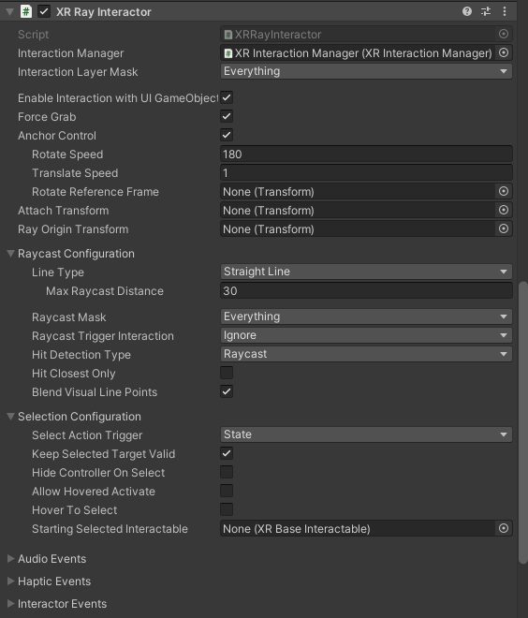
Interactors
When creating our VR interactions, we used an XR Origin (Action Based) object.
This object comes with a Right and Left Hand Controller.
If you look at either of those Controllers, you will see this XR Ray Interactor component.
This component is what does the raycast and checks for Interactable objects.

Slide 6
Interactors
With the raycast, it allows us to interact with objects from a distance.
However, we might not want to give our players that mechanic.
Might make the game too easy, or feel unrealistic if the game is a simulation.
Instead, we can use another component called the XR Direct Interactor.

Slide 7
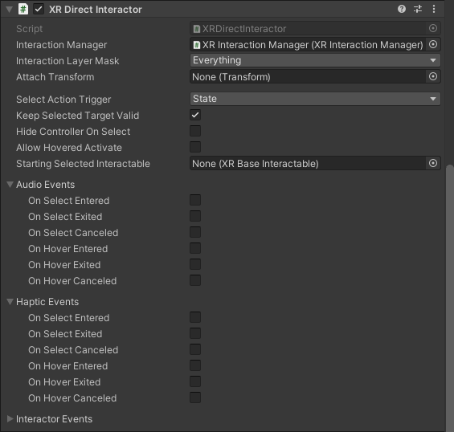
XR Direct Interactor
Unlike the Ray Interactor, the Direct Interactor does not cast a ray to check for objects.
Instead, it uses the collision system of Unity to check for Interactables.
This means that the player’s controllers must “physically” touch the Interactable object to interact with it.

Slide 8
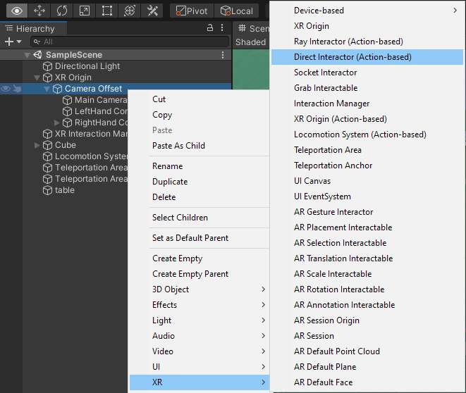
XR Direct Interactor
To make our Controller(s) use Direct Interactors instead of Ray Interactors, right click on the ‘Camera Offset’ object.
Then select XR > Direct Interactor (Action Based)

Slide 9
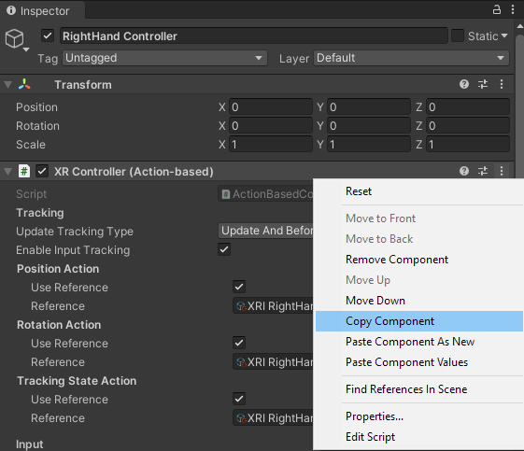
XR Direct Interactor
Next, select the original Controller object and look at its Inspector Window.
Look for the ‘XR Controller’ component and click on the meatballs icon on the right.
Then choose ‘Copy Component’
This step is needed because the newly created Direct Interactor does not have the correct input linked to it.

Slide 10
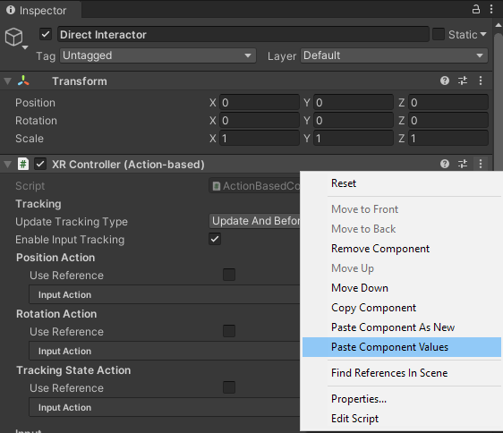
XR Direct Interactor
Now select the new Direct Interactor object and look for the ‘XR Controller’ component there.
Click on the meatballs icon and select ‘Paste Component Values’.
The values from last week’s Controller will now be pasted on our new object.

Slide 11
XR Direct Interactor
Once that is done, the old Controller with the Ray Interactor can be deleted.
It would be a good idea to rename the new Controller object to something like ‘Right Controller’ to keep things organized.
If the design of your game requires both of your controllers to use Direct Interactors, repeat the above steps for the other controller as well.
For this lesson, only one controller needs to be ‘converted’ to a Direct Interactor.
We will use the Ray Interactor next week.

Slide 12
Demo Time!

Slide 13
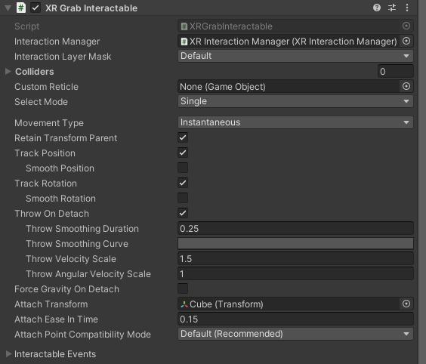
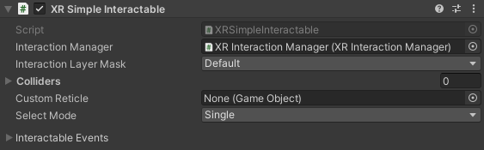
Event based Interactions
Grabbing objects is great, but what if we need other forms of interaction?
To implement other behaviours into an Interactable object, we can use the Event based system of an Interactable.
These Events can be found in the “Interactable Events” property in both the ‘XR Simple Interactable’ and ‘XR Grab Interactable’ components.

Slide 14
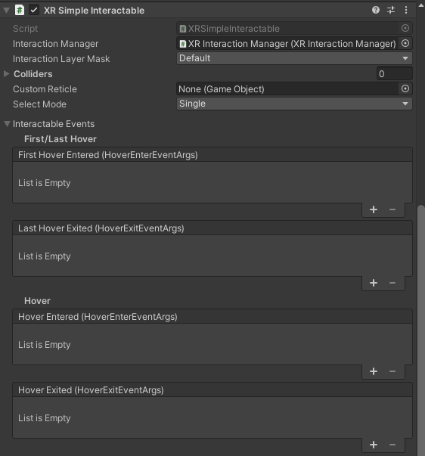
Event based Interactions
Expanding that property will reveal several events.
These events are similar to what we have seen when dealing with UI Buttons.
We can press the ‘+’ icon then link a function to be called when the event happens.
Information of what triggers the event(s) can be found by hovering over the headers (e.g. “First/Last Hover”, “Hover”)
This lets us quickly link our own code and behaviours to VR events.

Slide 15
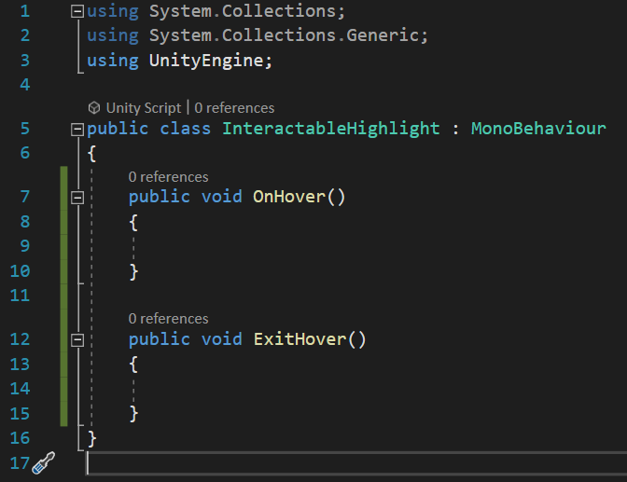
Event based Interactions
Let’s use these Events to quickly create a highlighting effect for Interactables when they are hovered over.
Create a new C# script in your project and name it “InteractableHighlight”.
Open the script in Visual Studio.
Create two functions to be linked to the hover and exit hover events.

Slide 16
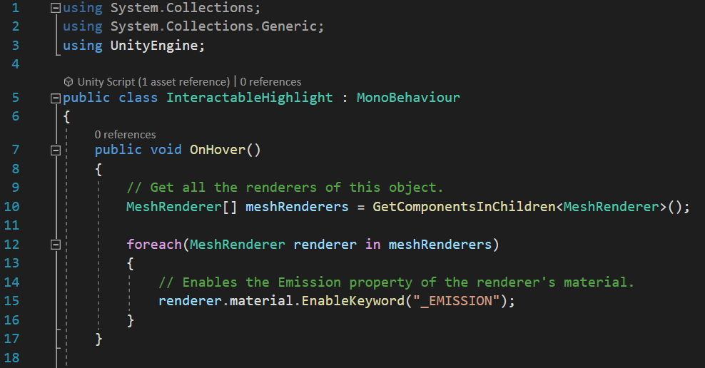
Event based Interactions
In the on hover function, we will look for all materials of our current object and turn on the ‘Emission’ property.
The ‘Emission’ property controls whether a material emits light as well as what color it emits.
We will use this to make our object highlight.

Slide 17
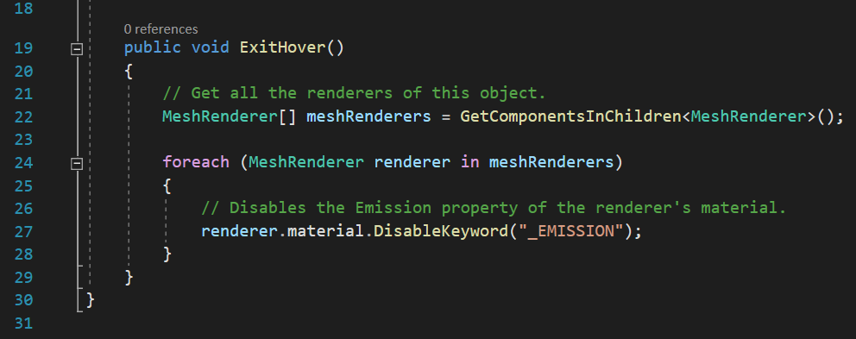
Event based Interactions
In the exit hover function, we can copy paste the same code over.
But instead of enabling the ‘Emission’ property, we will disable it instead.

Slide 18
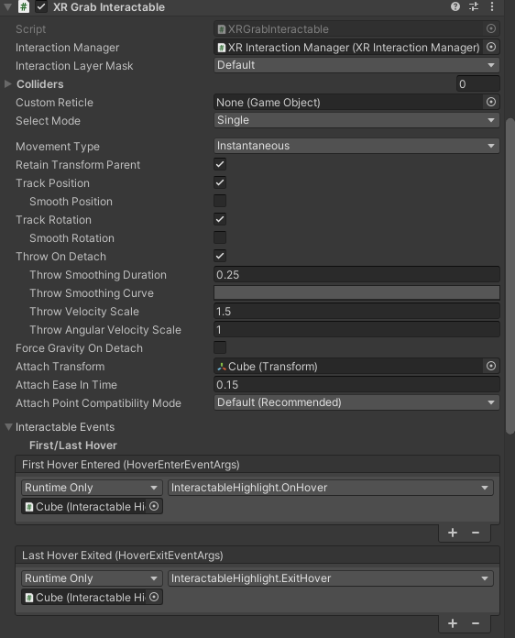
Event based Interactions
Once both functions are set up, we can drag the InteractableHighlight class to the Inspector of our object and add it as a component.
We can then link the functions to the First/Last Hover events of our Interactable object.

Slide 19
Demo Time!

Slide 20
Event based Interactions
Aside from highlighting an Interactable, we can use these events to implement other functionality.
We can use the Select Entered event to call a function when the Grip button is pressed while over an Interactable.
Let’s see how we can use this to create a light switch.

Slide 21
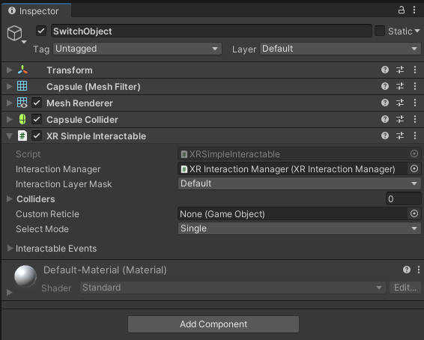
Event based Interactions
Create a new 3D object in the scene to act as the switch.
Then, go to its Inspector and add an ‘XR Simple Interactable’ component.
Add a Rigidbody component as well.
You can make it kinematic if you don’t want the object to move
This component differs from the Grab Interactable in that the Grab Interactable will cause the object to be grabbed by default, when the grip button is pressed.

Slide 22
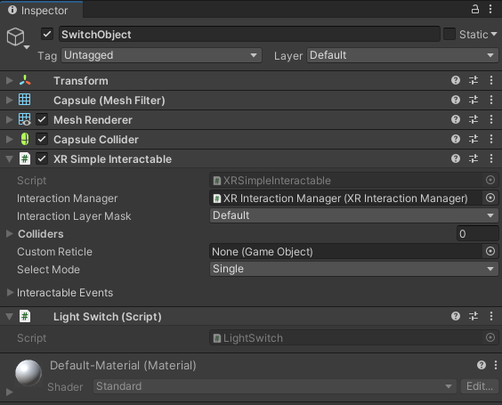
Event based Interactions
Create a new C# script, and name it “LightSwitch”.
Drag this class into the Inspector of the SwitchObject to add it as a component.
Open the “LightSwitch” class in Visual Studio.
Create a public Light variable
Create a public ToggleLight function

Slide 23
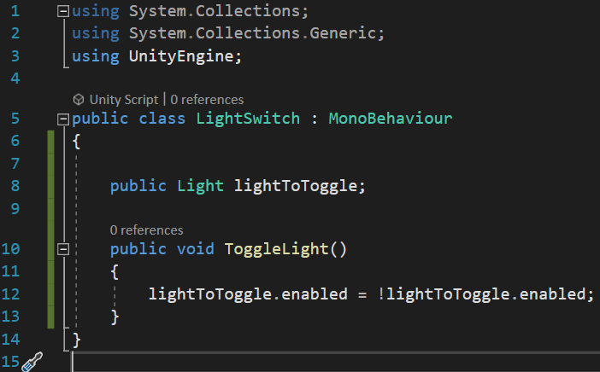
Event based Interactions
We will drag and drop the Light that we want to toggle later in the scene.
In the ToggleLight function, we will set the ‘enabled’ property of the Light variable to the opposite of its current value.

Slide 24
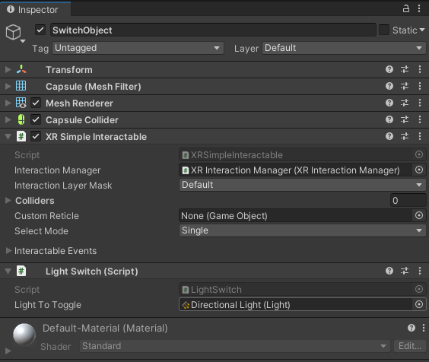
Event based Interactions
Back in the Unity scene, link a Light in your scene to the variable in the LightSwitch component.
I have chosen to use the default Directional Light for this example.
Once the link is done, we can connect the function to the Select event of the Simple Interactable.

Slide 25
Demo Time!

Slide 26
Socket Interactor
Often in VR, we might want objects to snap to a certain position when placed.
E.g. Chairs being pushed neatly into tables, mounting prizes onto walls, putting equipment back, etc.
To achieve these behaviours, we can use Socket Interactors from XRTK.

Slide 27
Socket Interactor
When added to an object, a Socket Interactor component will look for any Interactables that are “free” (not being grabbed or assigned to another Socket Interactor), and will snap the first detected Interactable to it.
For Interactables that are being grabbed, the Socket Interactor will still detect them, but won’t snap them into place unless the player releases their grip button.

Slide 28
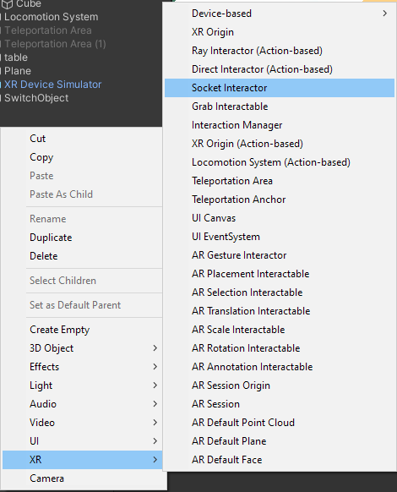
Socket Interactor
To create a Socket Interactor, right click in the Hierarchy and select XR > Socket Interactor.
A Socket Interactor object will be added, and it will consist of:
Transform
Sphere Collider
The Interactor will use this collider to detect objects
Socket Interactor

Slide 29
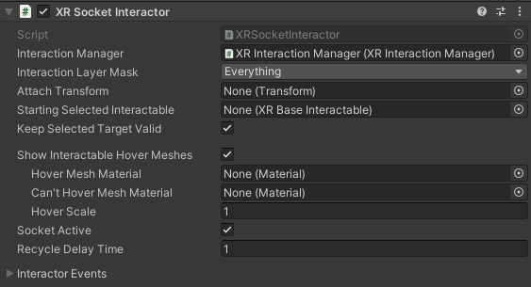
Socket Interactor
The Socket Interactor has many properties, but we will only look at a few key ones this lesson:
Interaction Layer Mask
This dictates which layers can be detected by the Socket Interactor.
Only objects in the selected layer(s) will be detected.
Useful for creating Socket Interactors that are ‘selective’.
Attach Transform
The Transform that the detected Interactable will snap to.
Hover Mesh Material
The Material to be used if the detected Interactable CAN be snapped to this Socket Interactor.
Can’t Hover Mesh Material
The Material to be used if the detected Interactable CANNOT be snapped to this Socket Interactor

Slide 30
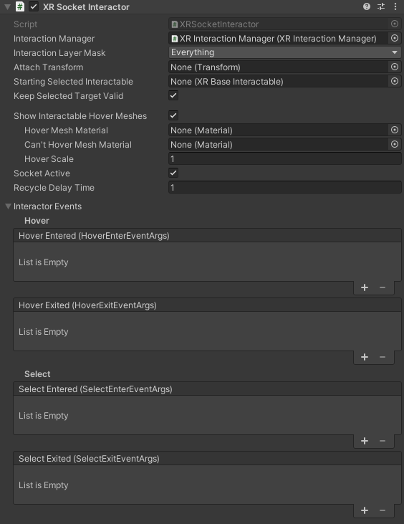
Socket Interactor
Aside from these properties, a Socket Interactor also contains events that can be used to linked to other functions.
The ‘Hover’ events will be triggered the same way as the Simple and Grab Interactable we’ve worked with.
The ‘Select’ events will be triggered when an item is snapped or removed from the Socket Interactor.

Slide 31
Demo Time!

Slide 32
Summary
To simulate reality, we might want to use Direct Interactors as they require our users to ‘physically’ touch the objects they want to interact with.
Using Events in Interactable components, we can link our code to VR interactions and create custom behaviours.
Socket Interactors give us the ability to create snapping points that our objects will snap to when released.

Slide 33
CA2 (Individual)
Each group member must create at least ONE new VR interaction for Assignment 2.
Examples:
Inserting a key into a lock using Socket Interactor and unlocking new content.
A puzzle where switches must be selected in order to solve it.
An object that users can pick up and use to hit/eliminate other objects (think Beat Saber).
This will be due during next week’s lesson when we have our consultation in class.

